Slide 1
Finance Committee March 2024 Update
April 18, 2024

Slide 2
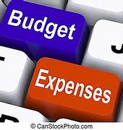





Agenda *Investment Update
Budget to Actuals
Sales Tax Collection
Investments
Utility Billing
Vacancies
Preview

Slide 3
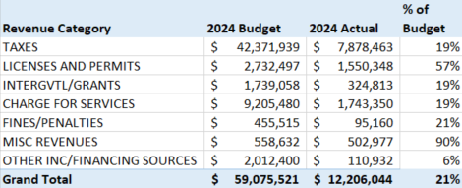
General Fund Revenues *82% of Budget for Permits
Notes:
Misc Rev: LGIP @5.4%, $214K; Opioid Settlements Rev $185K; Short Term Lease, $49K-Tower Lease WSDOT and Tmobile rental fees

Slide 4
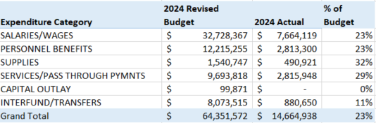
General Fund Expenditures by Category

Slide 5
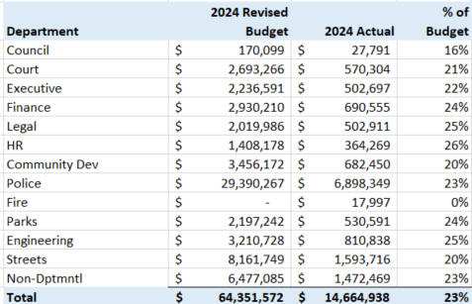
General Fund Expenditures Department Summary

Slide 6
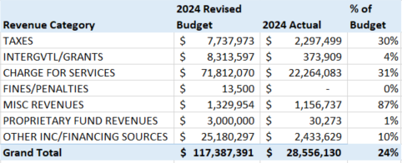
All Other Funds Revenues excluding General Fund 001 TBD, $1 million REET, $1.2 million

Slide 7
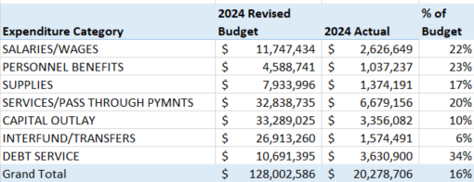
All Other Funds Expenditures excluding General Fund 001

Slide 8
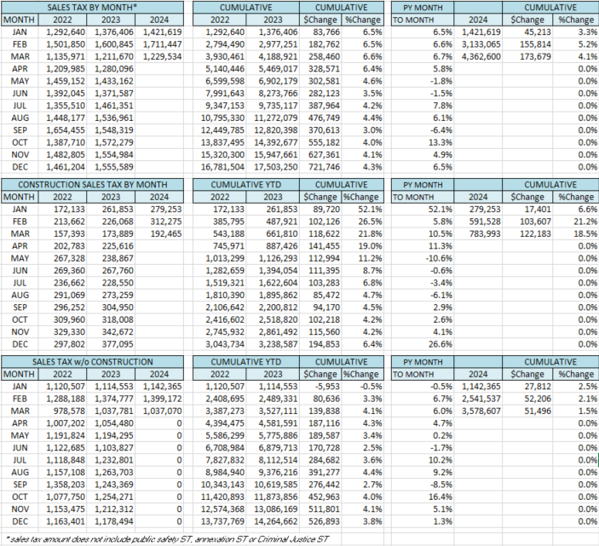
2024 Sales Tax
March Collection up 4.1%
Construction up 18.5%
Non-Construction up 1.5%
Reflects January data

Slide 9
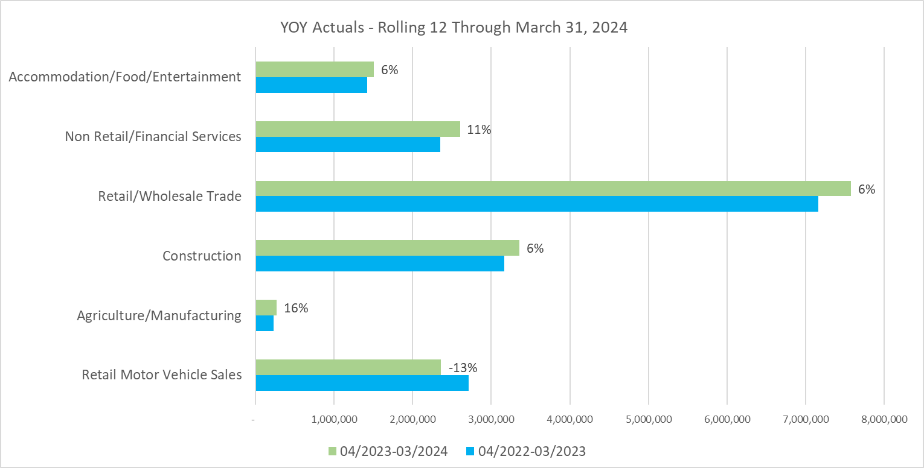

Slide 10
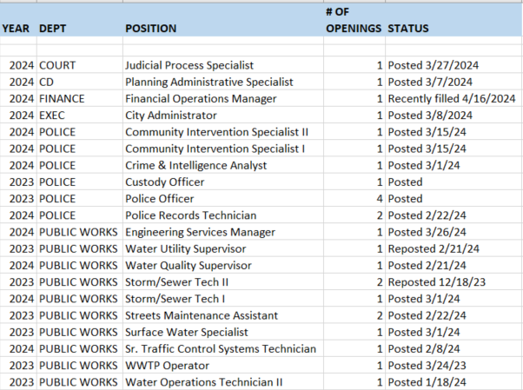
Total Open Jobs in 2024: 61 Active Recruitments: 26 Filled positions: 30

Slide 11
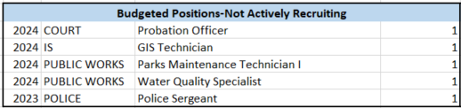
Budgeted, Not Actively Recruiting: 5

Slide 12


Accounts Receivable-Utility Billing

Slide 13
Questions?
Next Meeting
May 16th@ 11:30 am
County assessor presentation, may 13th

