Slide 1
Finance Committee January 2024 Update
February 15, 2024

Slide 2




Agenda *Liability Insurance Presentation
Budget to Actuals
Sales Tax Collection
Utility Billing
Vacancies

Slide 3
General Fund Revenues *Franchises from Waste Management, $493,265 and Comcast, $165,731

Slide 4
General Fund Expenditures

Slide 5
All Other Funds Revenues excluding General Fund 001 *Intergovernmental includes grants (WSDOT, DOC, CDBG, others) *Taxes include TBD, $334,496, and REET, $553,686

Slide 6
All Other Funds Expenditures excluding General Fund 001

Slide 7
2024 Sales Tax
January Collection up 3.3%
Construction up 6.6%
Non-Construction up 2.5%
Reflects December data

Slide 8
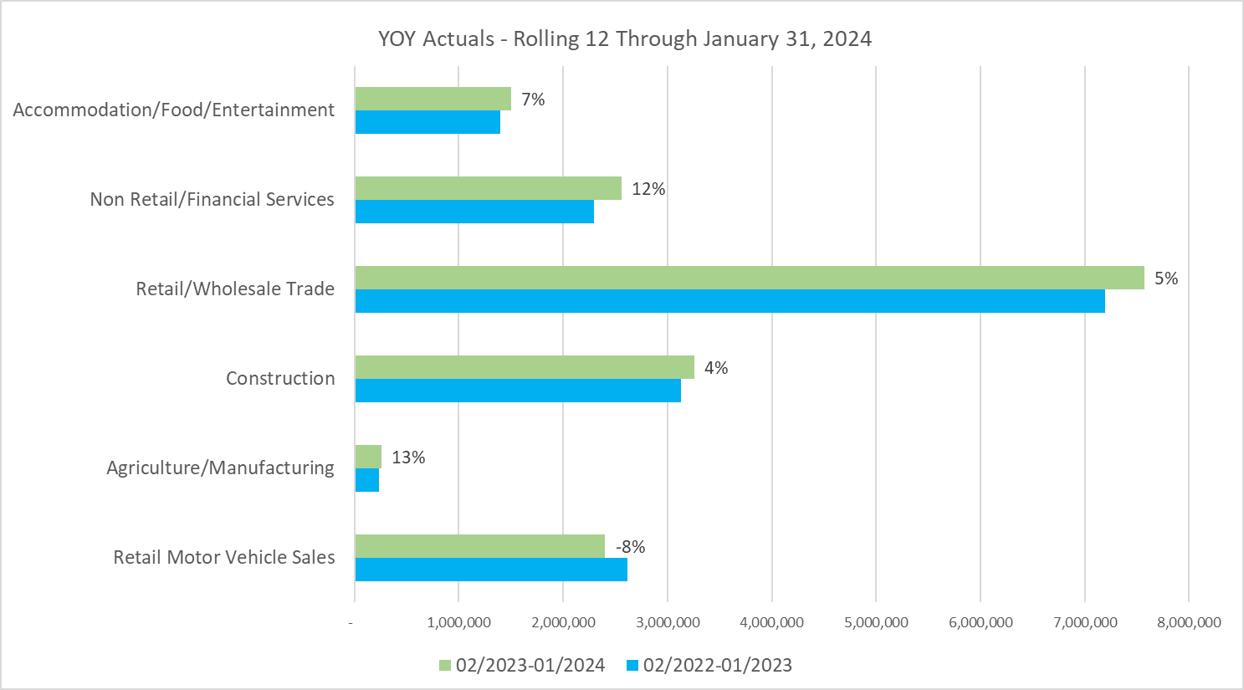

Slide 9
Total Open Jobs in 2024: 44 Active Recruitments: 18 Filled positions: 20

Slide 10
Budgeted, Not Actively Recruiting: 6

Slide 11
Accounts Receivable-Utility Billing

Slide 12
Questions?
Next Meeting
March 14th@ 11:30 am
Medical insurance
review
Council retreat
February 22nd

