Slide 1

2026-2031 Transportation Improvement Program (TIP)
Jeff Laycock, Engineering Services Director

Slide 2
Transportation Planning & Implementation
Long-Term | Mid-Term | Near-Term
Comprehensive Plan Transportation Element Capital Facilities Plan (CFP) Consistent with regional long-range plans (PSRC) Master Plans Sub-areas of City Incorporated into Comp. Plan Transportation Impact Fee (TIF) Funding based on demand created by development | Six-Year Transportation Imp. Program (TIP) Includes capital & developer improvements Identify planned funding Required for state & federal funds Regional TIP (PSRC) consistency | City Budget Capital Improvement Program (CIP) 2-year adopted funding 6-year funding plan Transportation Benefit Dist. (TBD) Sales tax to preserve, maintain, & expand infrastructure
 | Land Use Permits “Concurrency” with Comp. Plan Transp. Impact Studies for each development Mitigate direct impacts Preliminary design review | Construction Permits Detailed design review of development proposals Consistent with land use approval conditions
Notes:
This slide reviews the relative transportation documents including the Transportation Element and CFP from the General Comprehensive Plan as the basis for our 20-year planning period. This may include specific master plans. Every two years the City adopts a budget from projects within its Capital Improvement Plan.

Slide 3
2026-2031 TIP Summary
Annual adoption required by RCW 35.77.010
Transportation projects included:
Transportation Element “short term” & developer activity
Capital Improvement Plan (CIP)
Other funding pursuits, e.g. safety & maintenance grants, general programs
Split “Traffic Safety” & “Intersection” groups
Estimated expenses/funds & schedule
CIP (City budget)
Transportation Element cost estimates if not in CIP
Developer constructed: cost est. 3 or 6 years based on activity
Modified/updated based on grant application proposals or funding agreement if more detailed
Notes:
This year, we modified the TIP based on previous years to clean up the document. This will help as we transition to OpenGov.

Slide 4
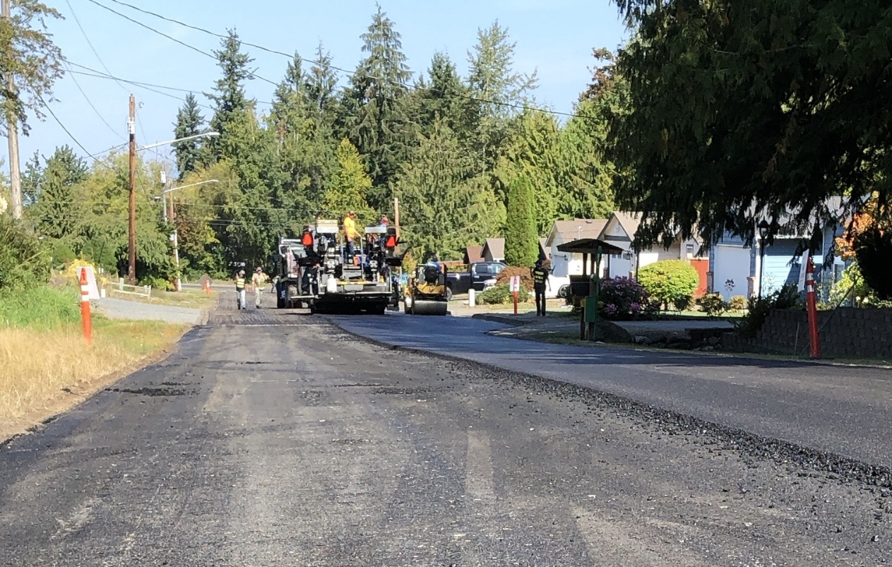
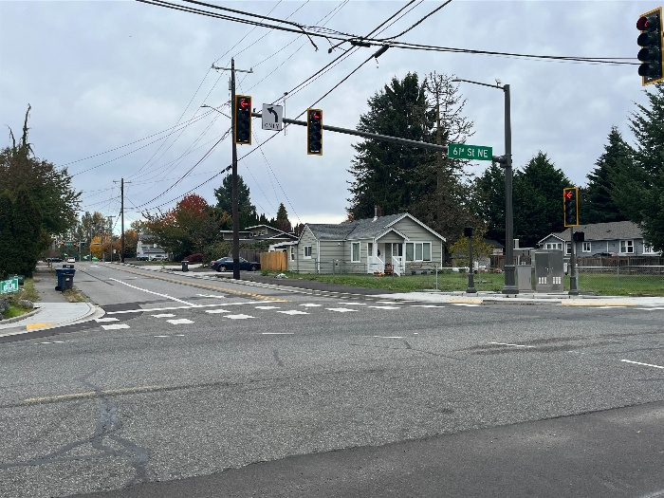
2025-2030 TIP Summary – Completed
Active Transportation Modes
Cascade Elementary Safe Routes to School – 100th St NE
Intersection
53rd Ave NE/
61st St NE
Pavement Preservation
67th Ave NE Overlay
2025 Pavement Preservation Project
Joint Agency
SR 529 Interchange
53rd/61st Intersection
73rd Dr NE, north of 49th Pl
Notes:
This list includes some of the TIP projects that will be completed or will be complete in 2025.

Slide 5
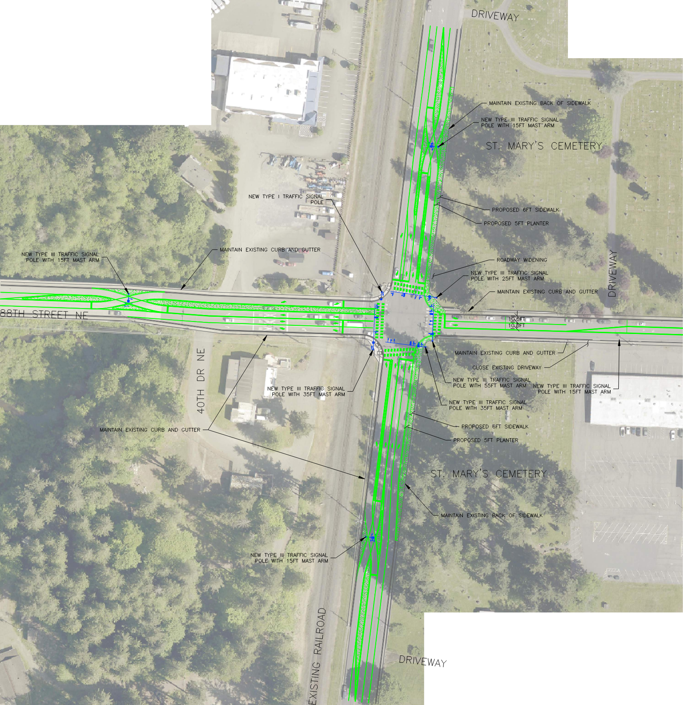
2026-2031 TIP Summary – New
Active Transportation Modes
Pinewood Elem. Safe Routes to School
55th Ave Sidewalk – 110th St to 95th Pl
Annual Bicycle Program *for opportunities
Intersections
State Ave/88th St Continuous Flow Intersection
Widening
152nd St – 51st Ave to City Limits
Pavement Preservation
Pavement Management System Update
State Ave – 116th St to Spur Track
Notes:
New projects were added to the TIP.
Pinewood – 84th ST NE SRTS Grant $1,082,000 towards construction
55th Sidewalk – project addition to provide pedestrian access to MNW
State Ave – 116th to Spur track includes a federal grant in the amount of $746,000

Slide 6
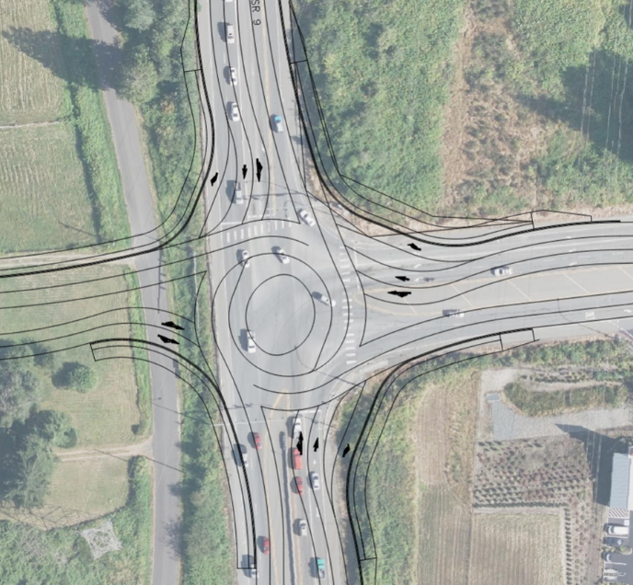
2026-2031 TIP Summary – New
New Roads
SR 9/SR 92 Roundabout *for new 35th St
23rd Ave NE – 172nd St to 169th Pl
169th St NE – English Crossing Blvd to 27th Ave
164th St NE – English Crossing Blvd to 27th Ave
27th Ave NE – 165th St to 164th St
40th St NE – 73rd Ave to 83rd Ave
Notes:
Some of these are listed streets were previously listed in the incorrect category and are now represented as new street segments. SR9/92 intersection was broken out as a new intersection improvement to convert the signalized intersection to a roundabout. This project is one of our legislative priorities.

Slide 7
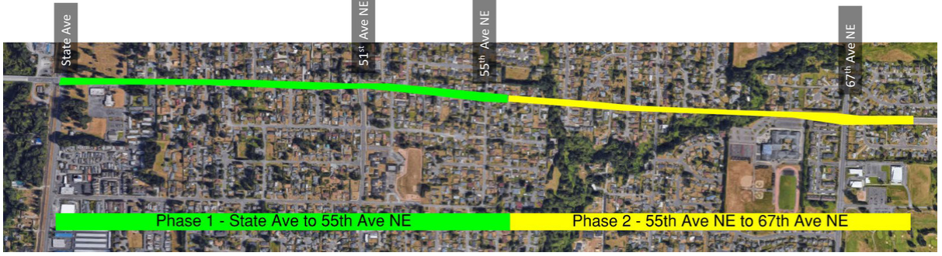
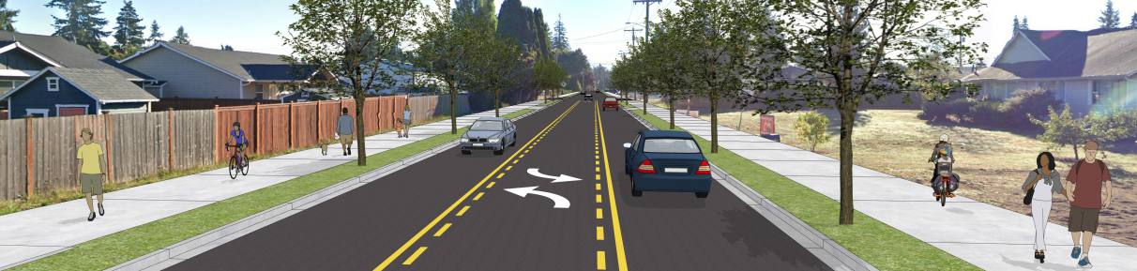
2026-2031 TIP Summary – Modified
Widening
88th St NE – State Ave to 67th Ave
Split into two projects/phases
New Roads
40th St NE – 73rd Pl to 83rd St
Previously Sunnyside Blvd to 83rd St “widening”
Long-range widening from Sunnyside Blvd to 73rd Pl
23rd Ave NE & 169th St NE
Previously combined as single developer project; split into two developer projects
35th St NE – SR 9 to 87th Ave
Previously included SR 9/SR 92 intersection improvements; split into two projects
152nd St NE – 51st Ave to 67th Ave
Developer conditioned from 51st to City Limits; City Limits to 67th Ave long-range other agency
Notes:
Some projects were modified based on updates from the comprehensive plan or to demonstrate what is complete. For example, the 88th corridor project was split into two phases.

Slide 8
2026-2031 TIP Summary – Funding Schedule
$1,000’s | 6-Years | 2026 | 2027 | 2028 | 2029-2031
Total (2 slides) | 372,914 | 59,358 | 51,630 | 60,897 | 210,030
Federal | 14,420 | 6,240 | 4,000 | 4,180 | -
HSIP | 940 | 940 | - | - | -
NHS | 6,702 | 3,702 | 3,000 | - | -
STBG | 6,312 | 1,598 | 1,000 | 3,714 | -
STP | 466 | - | - | 466 | -
State | 108,518 | 23,019 | 20,381 | 34,118 | 31,000
DOC | 557 | 557 | - | - | -
WSDOT | 103,992 | 20,107 | 19,849 | 33,036 | 31,000
SRTS | 2,529 | 915 | 532 | 1,082 | -
TIB | 1,440 | 1,440 | - | - | -
Notes:
Generalizations:
Federal funding relatively consistent over next 3 years; typically not awarded more than 2 years before project phase
Majority of state funding for I-5/4th St-88th St and 156th St interchanges. Otherwise 156th BNSF overcrossing design (~$5m).
Sum of federal 10-15% of all non-development next three years.
Grants still account for significant amount of transportation project funding.

Slide 9
2026-2031 TIP Summary – Funding Schedule
$1,000’s | 6-Years | 2026 | 2027 | 2028 | 2029-2031
Total (2 slides) | 372,664 | 59,108 | 51,630 | 60,897 | 210,030
City | 39,057 | 11,381 | 8,285 | 6,225 | 13,166
GENERAL | 12,882 | 5,343 | 2,507 | 2,009 | 3,292
TBD | 20,907 | 4,038 | 4,384 | 3,216 | 9,000
TIF | 5,268 | 2,000 | 1,394 | 1,000 | 874
Other | 210,919 | 18,718 | 18,964 | 16,374 | 156,864
DEVELOPER | 108,121 | 17,918 | 12,764 | 14,774 | 62,666
COUNTY | 500 | 500 | - | - | -
UNSECURED | 102,298 | 300 | 6,200 | 1,600 | 94,198
Notes:
Generalizations:
Omitting WSDOT interchange & developer funds, City funds 18-28% in 26-28 → leveraging of City funds for grant/appropriation funds.
Developers incl. TIF – Estimate range from 25-35% of all transportation improvement funding.
“Unsecured” $300k funding in 2026 and after is for annual sidewalk & bicycle programs, included for potential small scale grant opportunities or City funding

Slide 10
Questions?

