Slide 1
2026 TRANSPORTATION BENEFIT DISTRICT (TBD) PROJECTS
November 24, 2025

Slide 2
2025-2026 TBD Snapshot
Estimated revenue, planned TBD expenditures and year-end balances are shown below.
 | 2025 | 2026
Carryover Revenue | $8.33M | $8.53M
Projected Revenue | $5.36M | $4.62M
Estimated Expenditures | $5.13M | $6.98M
Remaining Balance | $8.53M | $6.17M

Slide 3
2026 TBD Projects
Project Name | 2026 TBD
2026 Pavement Preservation (All)** | $4,215,000 (increase $1.215M)
55th Ave NE Sidewalk (All)* | $1,284,090
61st St NE Paving and Sidewalk (Construction)* | $900,000
Pinewood Safe Routes to School (Design)* | $127,000
67th Ave NE/52nd St NE Intersection (Design)** | $50,000
88th St NE and State Ave CFI (Design)** | $250,000
Pavement Management System Update** | $150,000
TOTAL | $6,976,090
* New project, **Included in 2026 CIP/Budget

Slide 4
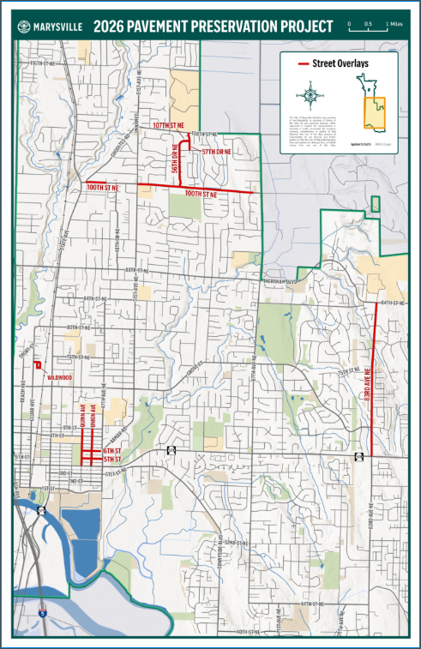
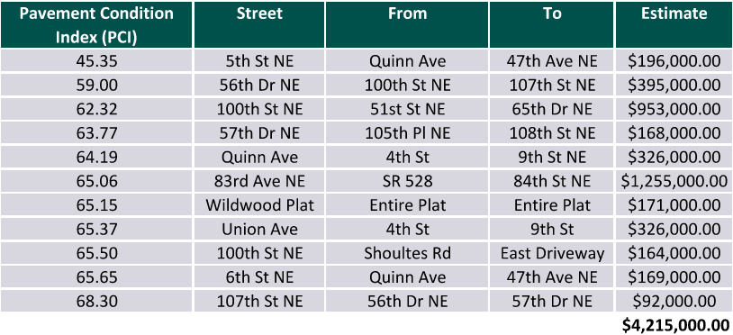
2026 Pavement Preservation
Repair Only
Includes 4 miles of paving and replacement of 145 curb ramps
* Estimated construction cost
*
Notes:
As with all pavement preservation projects, we will also look into pavement markings to incorporate planned elements (ie. bike lanes, etc)

Slide 5
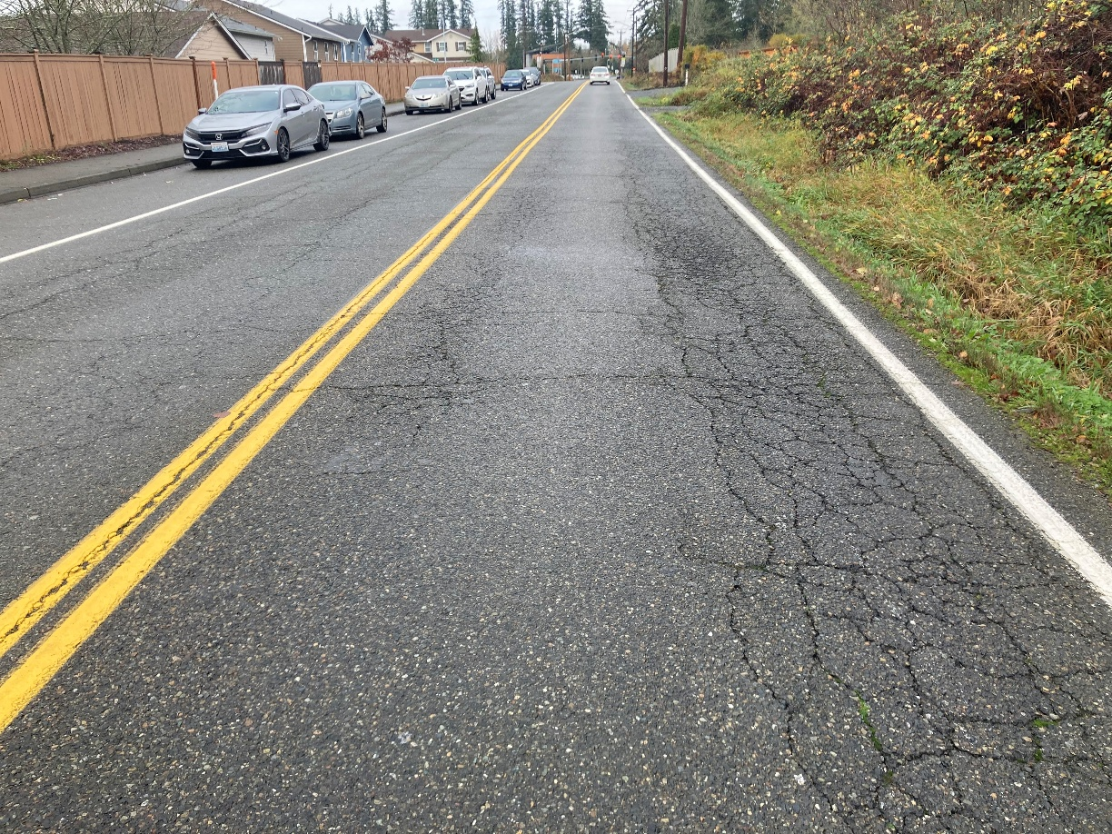
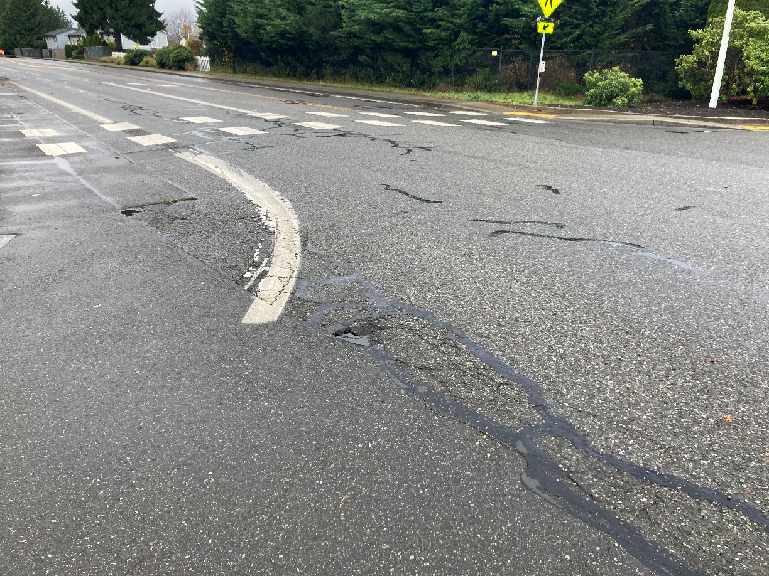
2026 Pavement Preservation
83rd Ave NE (At 83rd St NE – Looking North)
100th St NE (At 56th Dr NE – Looking Northwest)

Slide 6
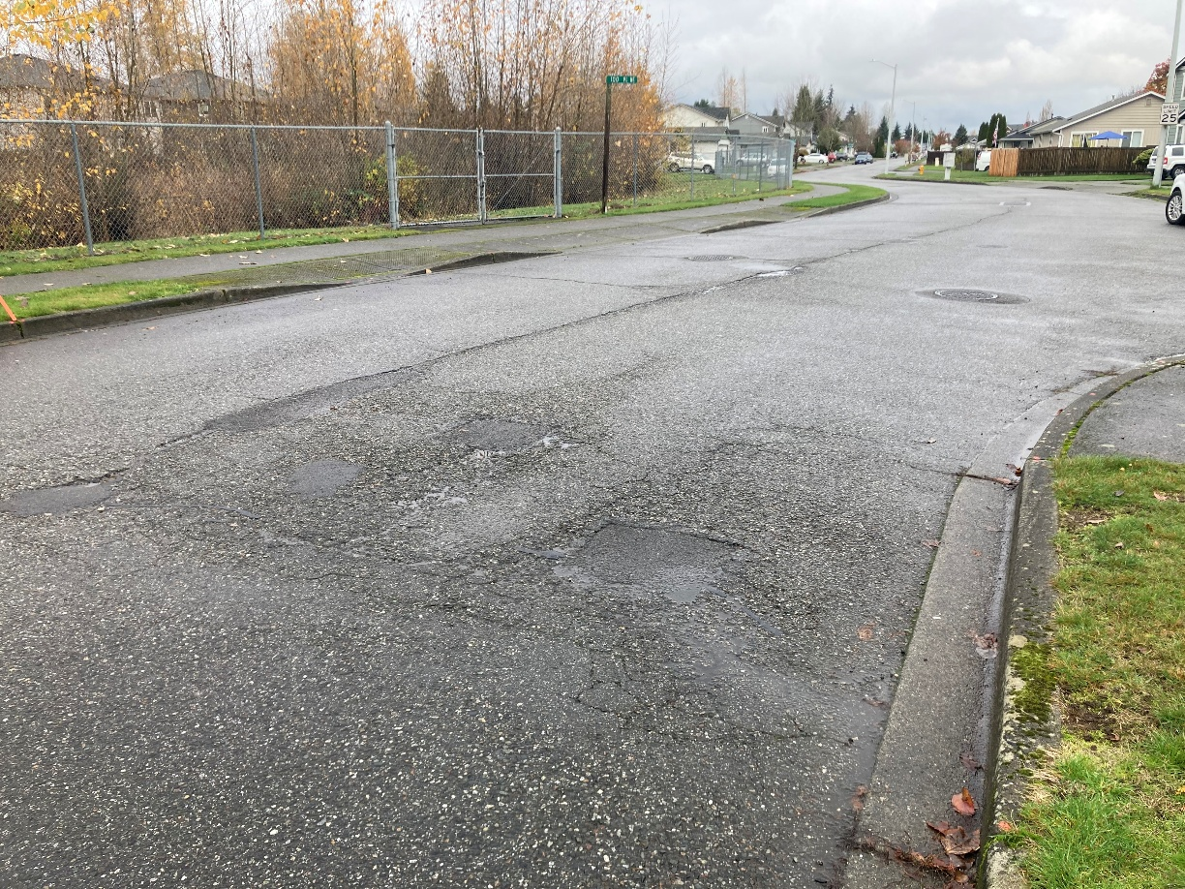
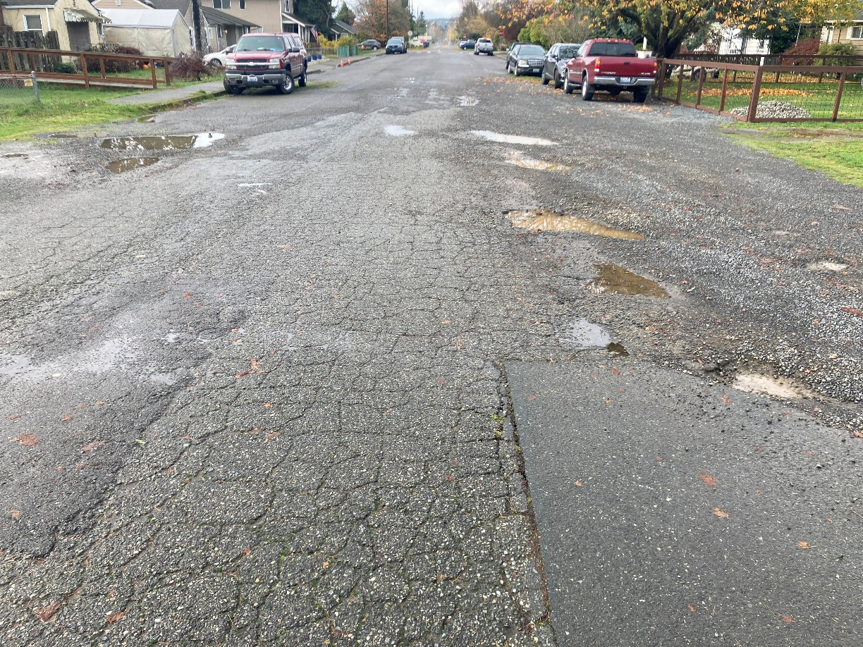
2026 Pavement Preservation
56th Dr NE (At 100th Pl NE – Looking North)
5th St (West of 47th Ave NE – Looking West)

Slide 7
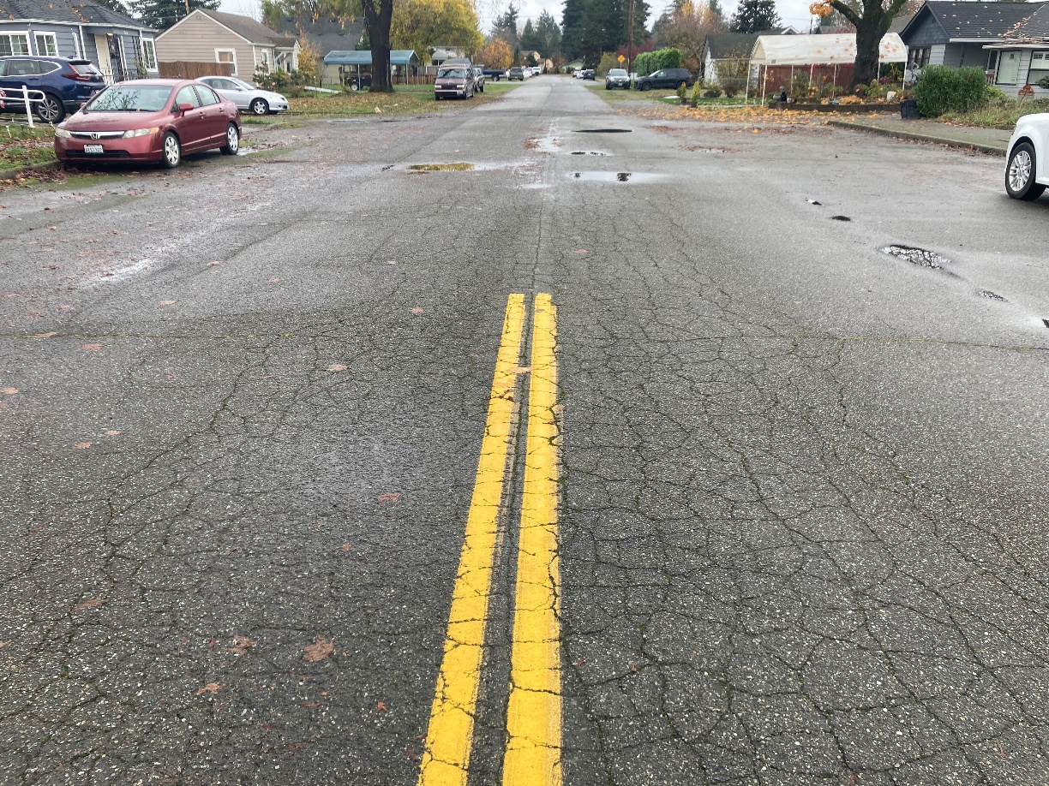
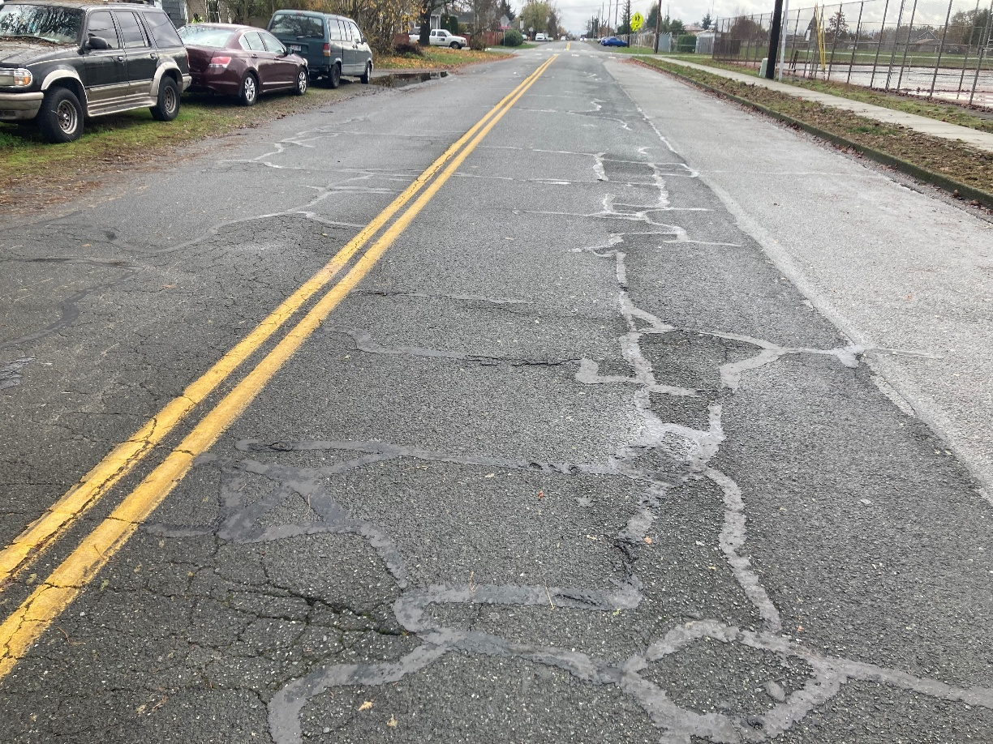
2026 Pavement Preservation
6th St (East of Quinn Ave – Looking East)
Quinn Ave (South of 8th St – Looking South)

Slide 8
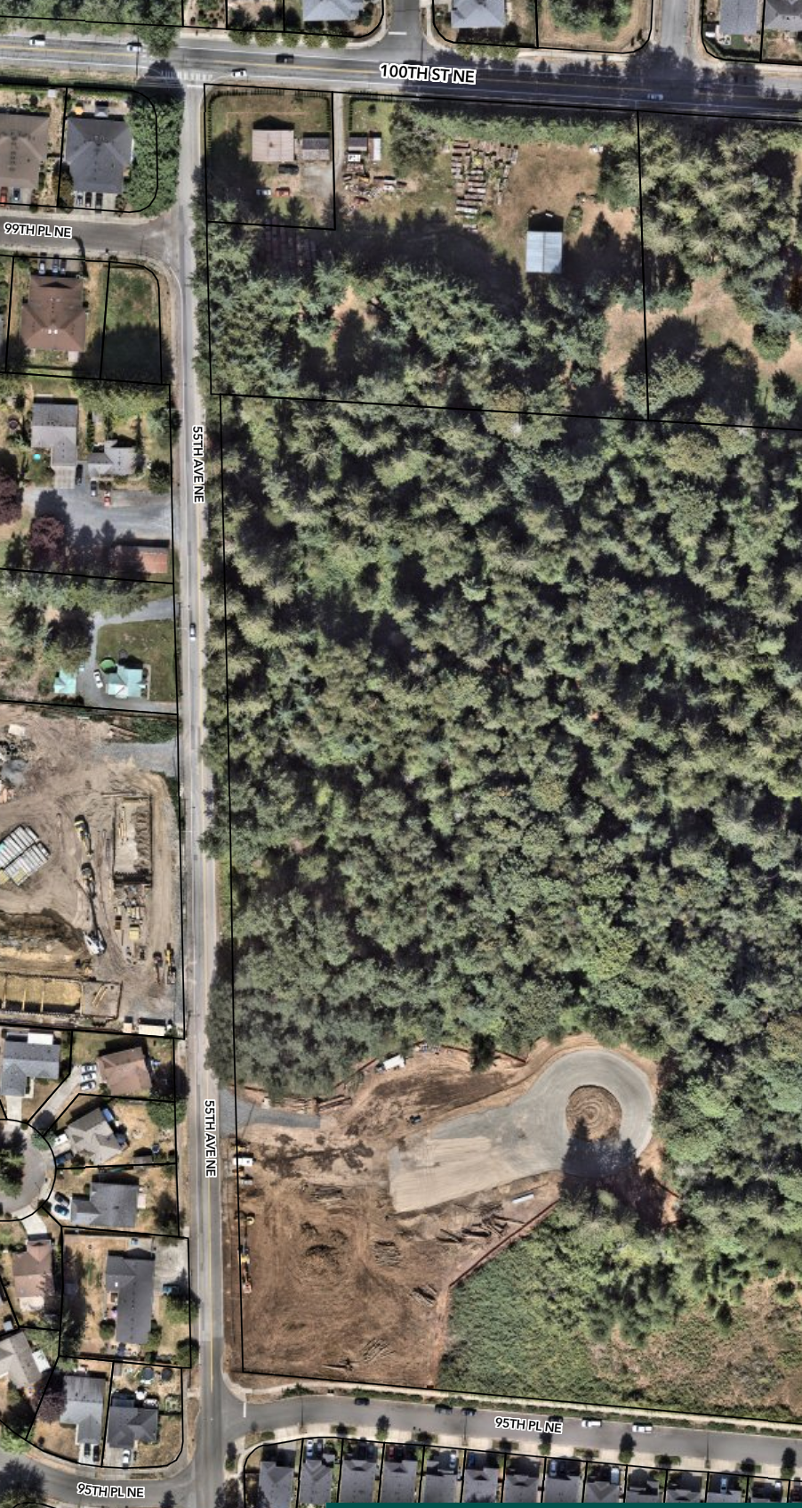
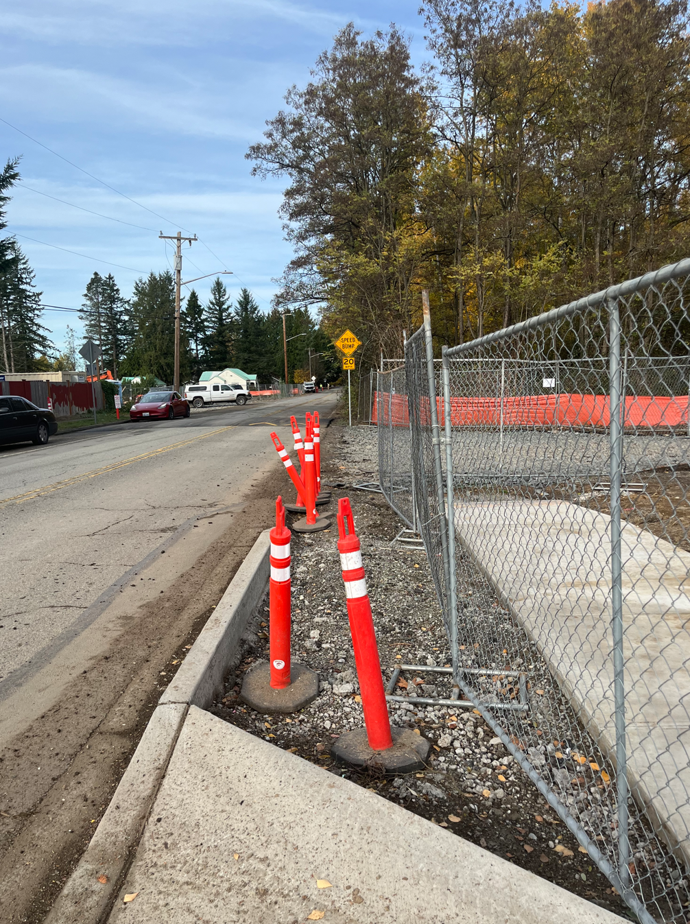
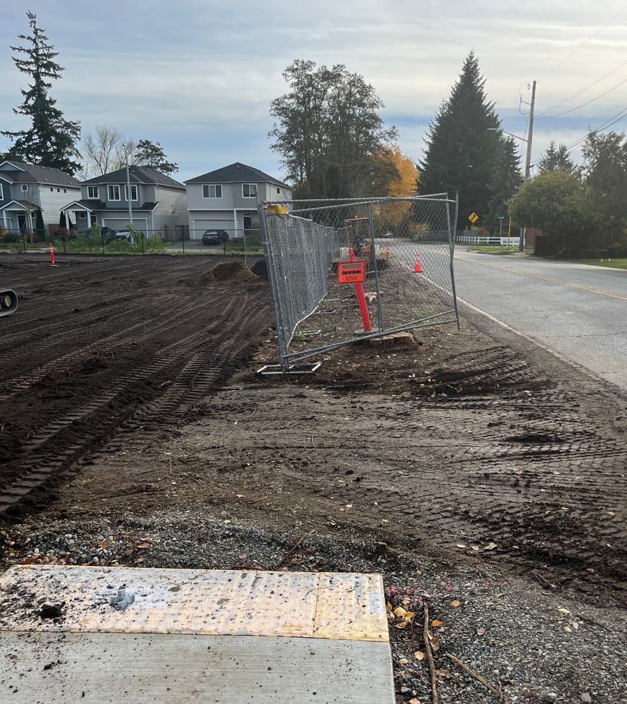
55th Ave NE Sidewalk
Project Scope:
This project will provide essential pedestrian connectivity to Mother Natures Window Park along 55th Ave NE.
Construct 210’ of sidewalk frontage improvement to complete gap from 95th Pl NE to new park entrance at Mother Nature’s Window Park, scheduled completion by April.
Construct 1025’ of sidewalk frontage improvement from new park entrance at Mother Natures Window to 100th St NE. TBD funds will be used to design and acquire right-of-way in 2026, with the potential to construct in 2026 or into 2027.

Slide 9
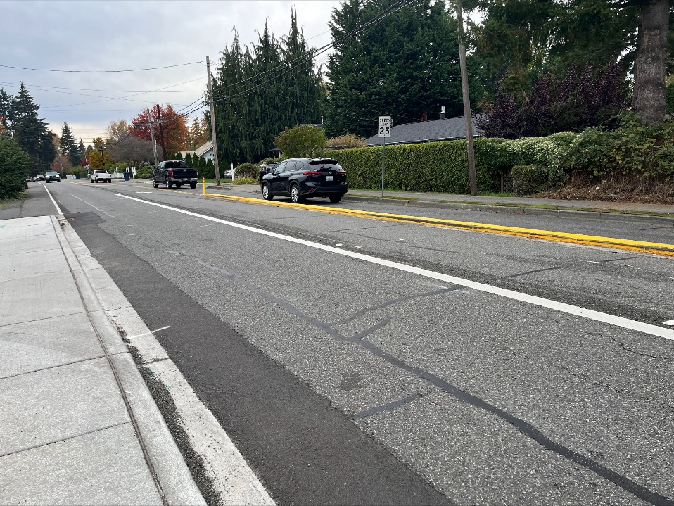
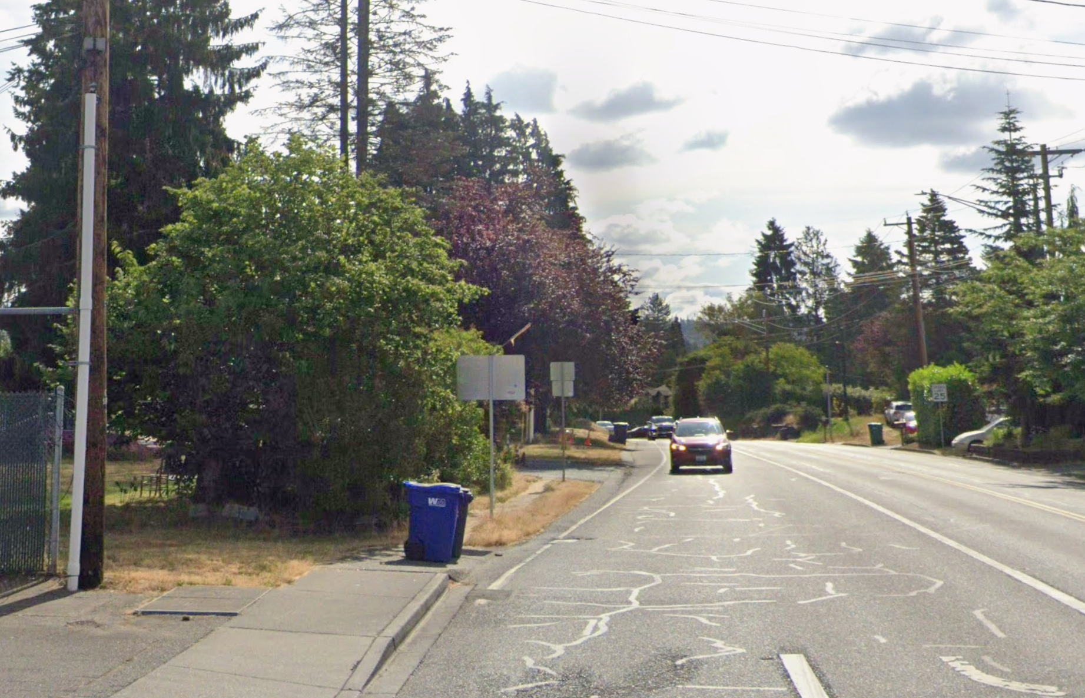
61st St NE Paving and Sidewalk
Project Scope:
With construction of Phase 4B of the Ebey Waterfront Trail scheduled for 2026, 61st St NE is in need of resurfacing. Partial reconstruction and overlay of 61st St NE between 47th Ave NE and 53rd Ave NE will be included as a separate schedule in the trail project. In addition, sidewalk will be added on the north side of 61st St NE just east of 47th Ave NE to complete this gap.

Slide 10
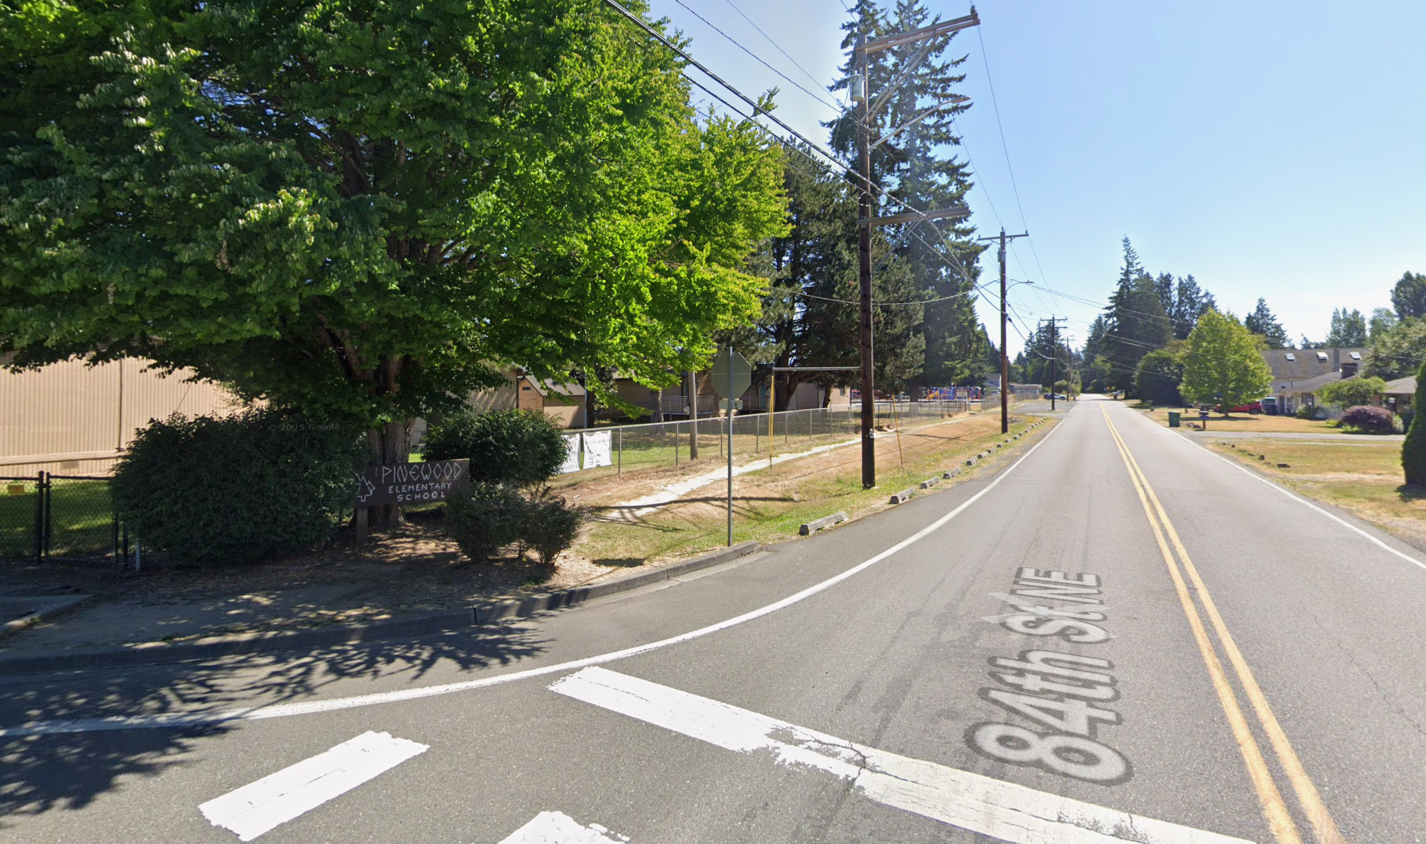
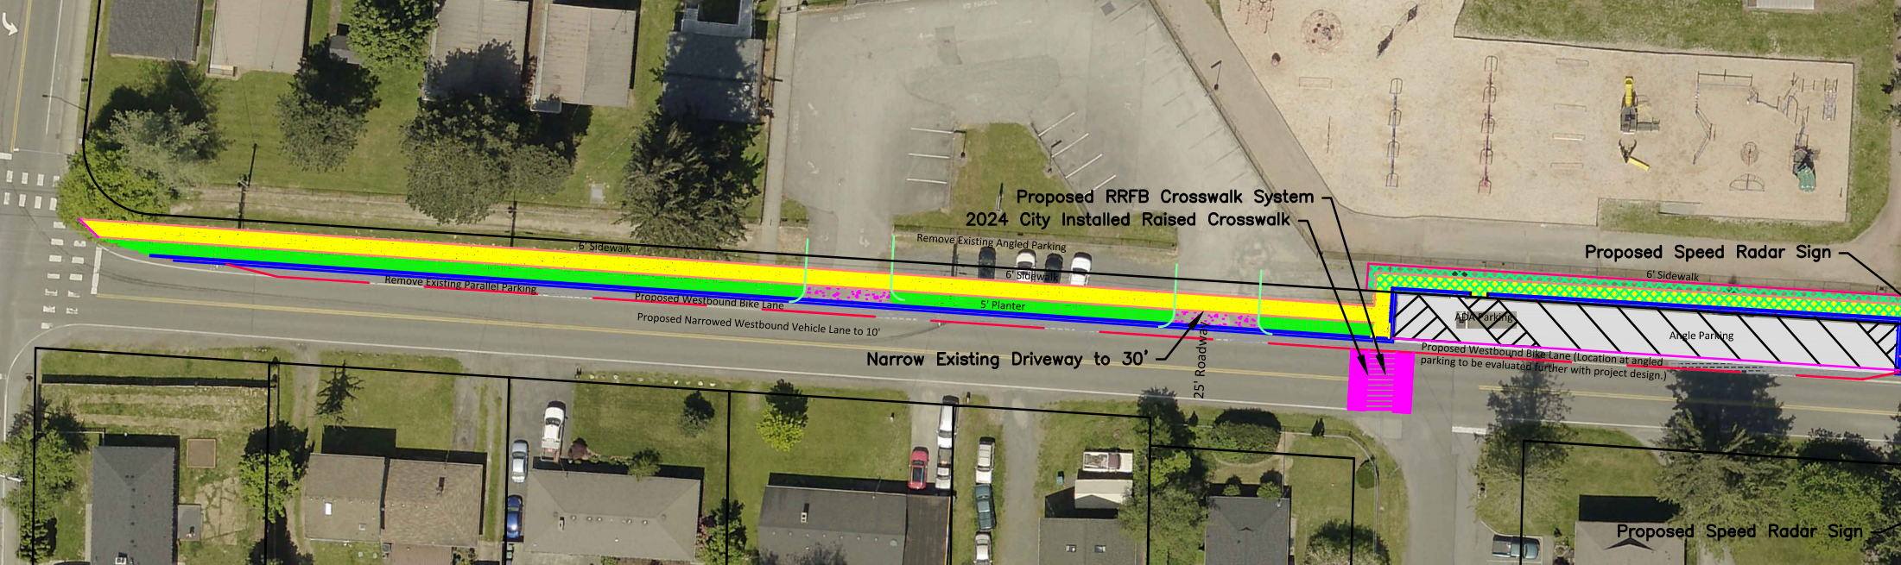
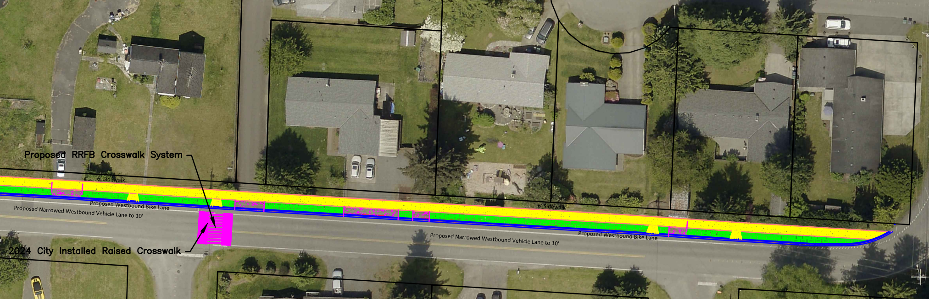
Pinewood Safe Routes to School
Project Scope:
This project will construct sidewalk and other various improvements on 84th St NE between 51st Ave NE and 55th Ave NE. The City was awarded a safe routes to school grant in the amount of $1,082,000 towards construction scheduled for 2028. TBD funds in 2026 will be used towards design.

Slide 11
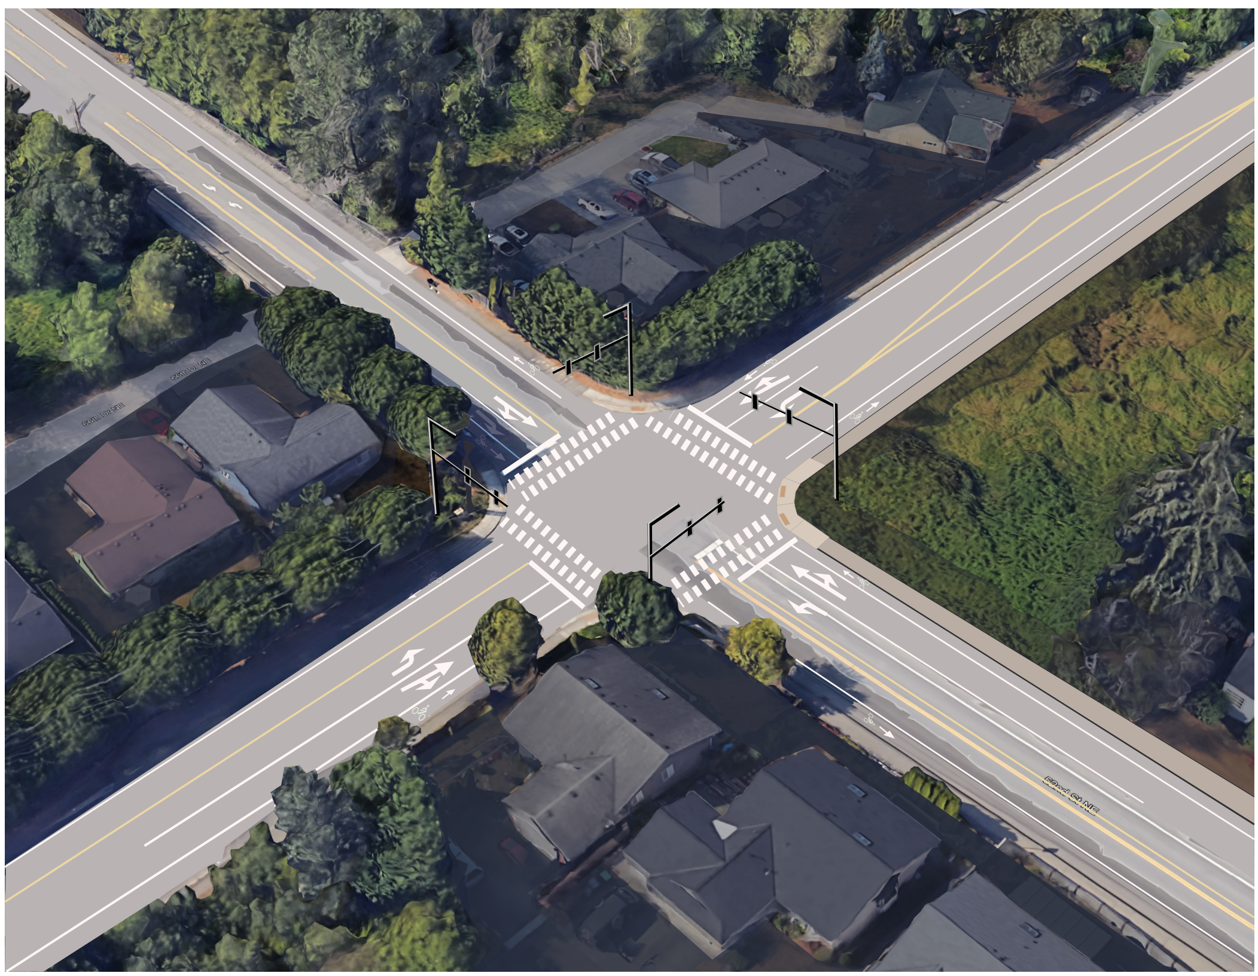
67th Ave NE & 52nd St NE Intersection
Project Scope:
Construct left-turn lanes, bike lanes, traffic signal, ADA ramps and sidewalk at this all-way stop controlled intersection. Design is partially funded by a WSDOT grant. Design and permitting will continue in 2026.
Project Schedule:
2024-2026 Design
2027-2028 Right-of Way
2029 Construction (Unfunded)

Slide 12
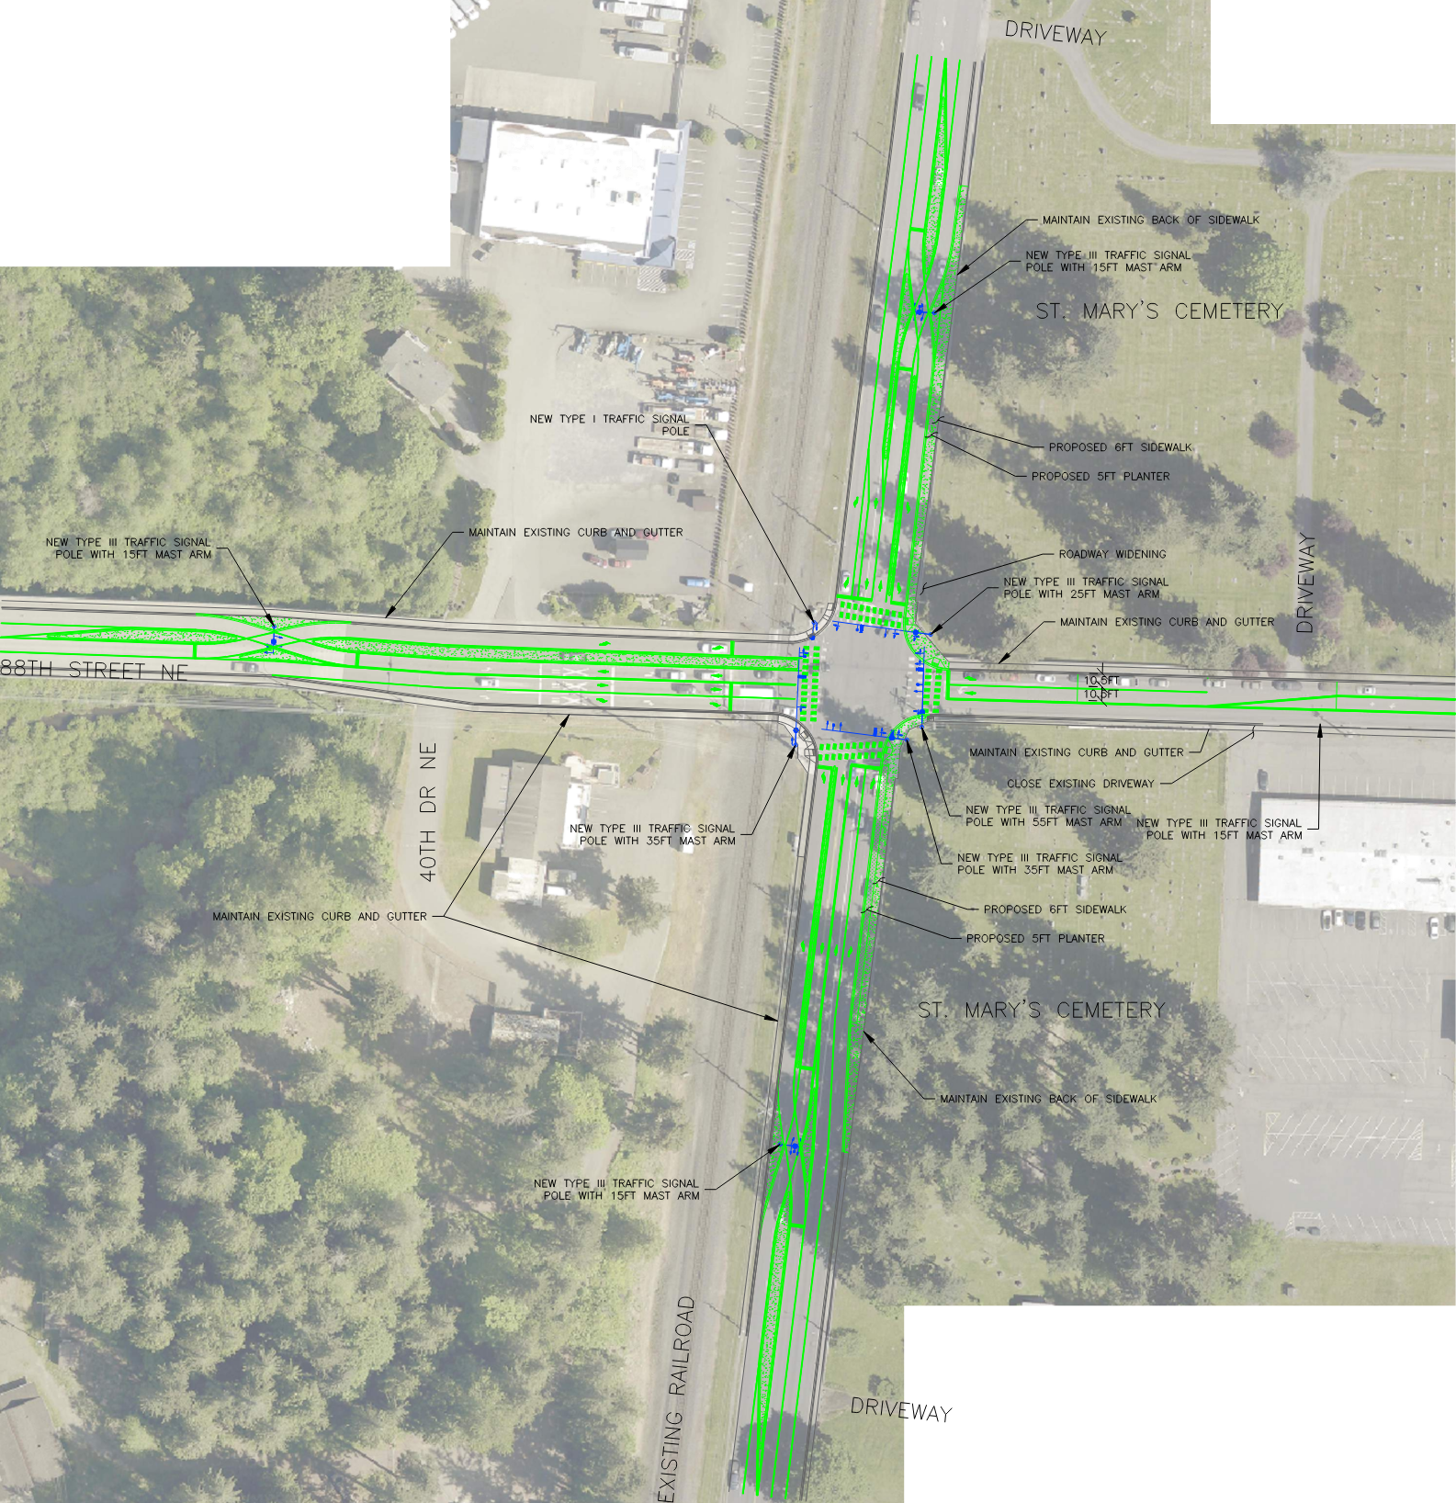
88th St NE and State Ave CFI
Project Scope:
Desing and construct a continuous flow intersection (CFI) improvement at 88th St NE and State Avenue. Work on this project, beginning in 2026, will include refinement of conceptual design and development of visual aids with public engagement.
Project Schedule:
2026-2028 Design
2028 Right-of Way (Unfunded)
2029 Construction (Unfunded)

Slide 13
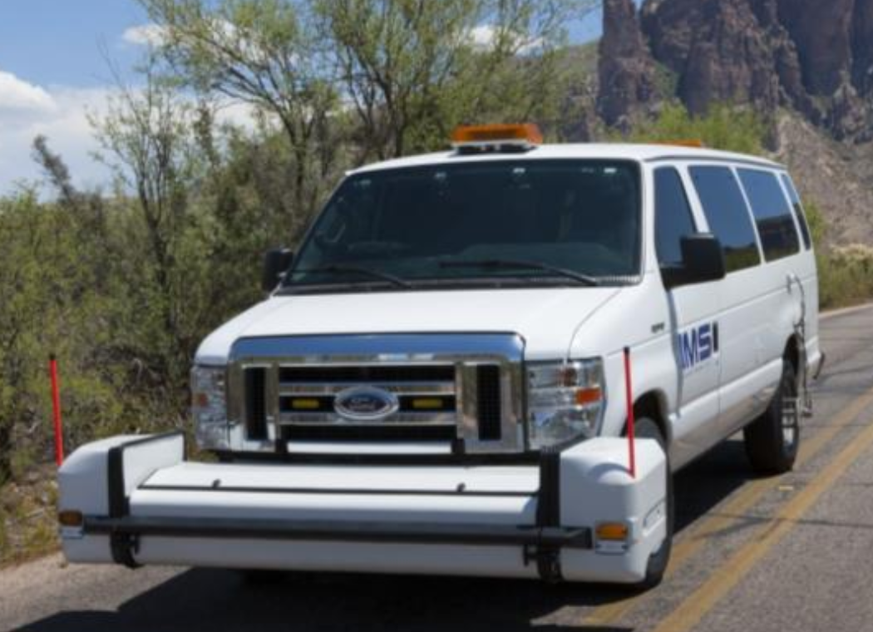
Pavement Management System Update
Project Scope:
Conduct pavement ratings on all city streets and update our pavement management system. Evaluate overall pavement condition index (PCI), program funding and development of pavement preservation program (10-year project list)

Slide 14
Questions

